Slide 1
Analog Electronics Lab Experiment-3
Instructors name:
P3:
Ashish Kumar Varma
Sambhavi Shukla
P4:
Ankita Dixit
Premsai Regalla

Slide 2
Active Filters using OPAMP

Slide 3
Objective
To study of active filters using Op-Amp
Low Pass Filter
High Pass filter
Band Pass filter

Slide 4
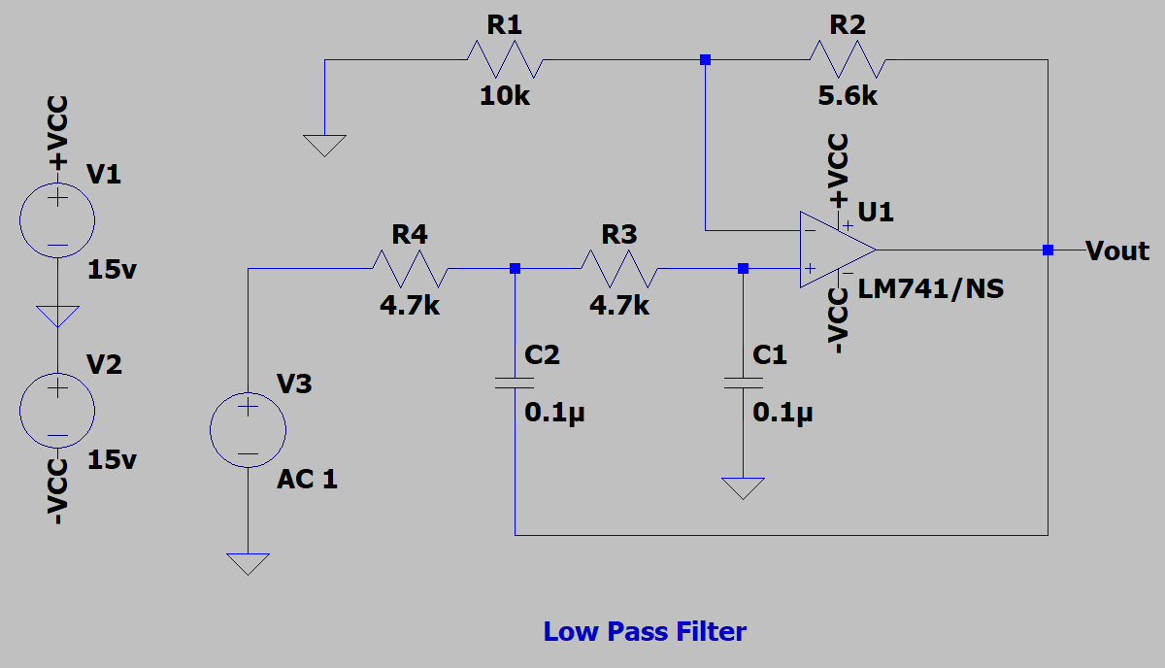
Low Pass Filter (LPF)

Slide 5
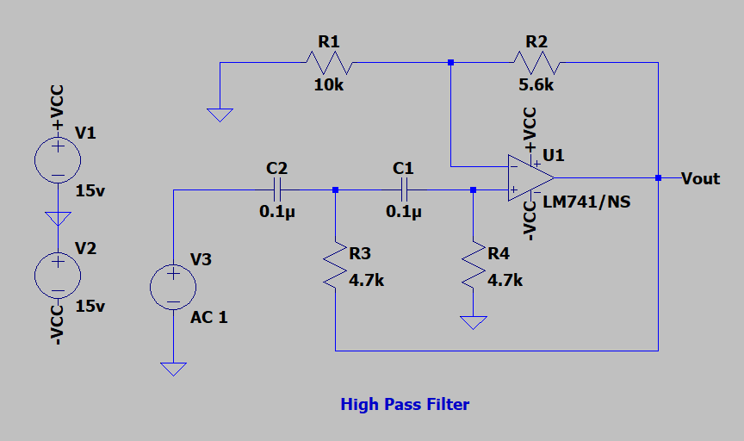
High Pass Filter (HPF)

Slide 6
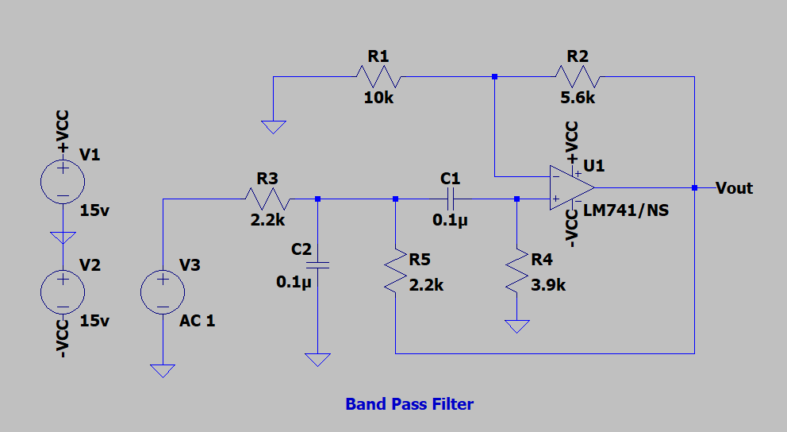
Band Pass Filter (BPF)

Slide 7
Assignment:
To study the Active Filters using OPAMP (IC-741)
1) Low Pass Filter (LPF)
2) High Pass Filter (HPF)
3) Band Pass Filter (BPF)
Upload a single PDF file on Nalanda which includes
1) Circuit diagrams for all three configurations.
2) Plot the voltage gain versus Frequency for all the three types of active Filters .
3) Calculate the 3-dB cut-off frequency and compare your simulated values with the theoretical ones in tabular form.
Submit the report in a single PDF format (file name should be your ID) on Nalanda within 48 hrs., after your lab section. ( 2 marks deduction for late submission ) Personal submission on email will not be considered.

Slide 8
